Slide 1
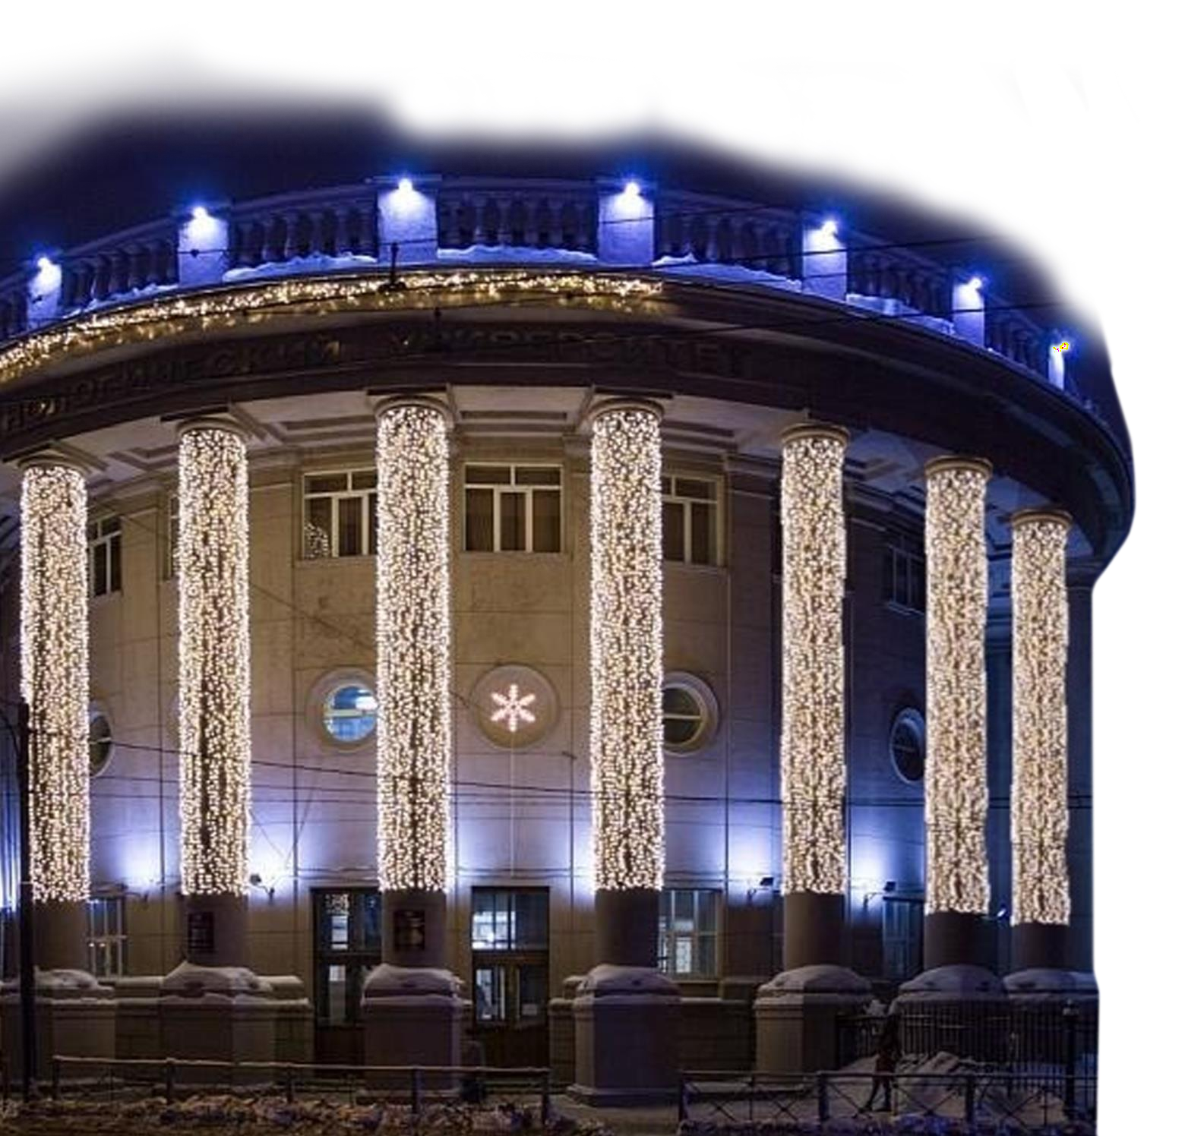
Kazan National Research Technological University
www.knitu.ru

Slide 2
KAZAN
One of the largest economic, scientific, educational, cultural and sports centers in Russia
the population over
1,250,000
in the list of
UNESCO
World Heritage
was founded more than
1,000
years ago
cities
2

Slide 3
OUR HISTORY
Kazan Industrial College
1890
Kazan Institute of Chemical Technology
1930
Kazan National Research Technological University
2010
1919
Kazan Polytechnic
Institute
1992
Kazan State Technological
University
2020

Slide 4
KNRTU in Rankings
1
In Chemical Engineering among Russian universities
801+
In the list of World University Subject Rankings: Engineering and Technology
158
In QS BRICS Ranking

Slide 5
The Structure of KNRTU
Representation in Vietnam
Branch in the city of
Kant (Kyrgyzstan)
30
Complex laboratories
Education sector abroad
ICPE
Institute of
Research-laboratory complex
Chemical and
ECTI
Engineering
Petroleum Engineering
IPCN
Institute of Petroleum,
Branch in Bugulma
BB
NCTI
38
Chemical -
Chemistry and Nano-
SIE
Nizhnekamsk Chemical Technological Institute
Technological
Institute
technologies
Branch Network
ILITFD
Institutes
IFPB
Institute of Food
Small innovative enterprises sector
Institute of Light Industry
Production and
Technologies, Fashion and
Biotechnology
Boarding lyceum for gifted children
Kazan Technological College
Design
Chemical Industry Union
Project Institute
BL
KTC
IP
Institute of Polymers
IIM
Institute of Innovation
Management
IMAIT
Innovation units
Institute of Management,
Automatization and
Faculty of secondary
vocational education
Information Technologies
FSVE
FC
Continuing education
sector
Kazan Food College
Technopark
CDSTE
EC (NK)
EC “Chemical Engineering”

Slide 6
KNRTU Today
> 250
professors and doctors
of sciences
More than
24,000
students
~900
PhD

Slide 7
130
A Number of Principal Educational Programs
156
Master’s degree
programs
0
Bachelor’s degree
programs
17
secondary vocational Education programs
46
PhD programs

Slide 8
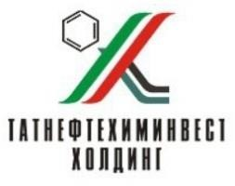
KNRTU Key Industrial Partners

Slide 9
University Development Priorities
New technologies
New materials
Cluster of technologies for sustainable
development
CHEMISTRY AND TEHNOLOGY
OF ADVANCED MATERIALS
Polymer materials; chemistry of large-scale polymers and rubbers production; chemistry of advanced polymers (including biodegradable) and synthetic rubbers; technologies for processing polymers, elastomers and composites; supramolecular chemistry system, synthesis and research of ultrafine inorganic and organic materials, composites, nanomaterials and coatings properties.
HIGH-PERFOMANCE ENERGY- INTENSIVE MATERIALS, ARTICLES AND INNOVATIVE TECHNOLOGIES OF THEIR PRODUCTION
Synthesis and technologies of highly explosive materials, gunpowders, solid rocket fuel and pyrotechnic compositions, and products on their bases; process safety and explosive production theoretical foundations; industrial explosives, pyrotechnic devices increasing oil recovery factor, new energy-intensive materials properties modeling and forecasting, etc
ENERGY- AND RESOURCE- SAVING ECOSAFE TECHNOLOGIES, INCLUDING “GREEN CHEMISTRY”
Fundamentals, technological solutions and complex technologies for the intensification of oil and natural bitumen extraction, collection, transportation and treatment using nanostructured composites, energy and resource conservation in the following areas: technologies of organic and inorganic substances, electrochemical technologies, plasma- chemical, supercritical fluid and nano-technologies, bioconversion of basic plant raw materials, etc.
CHEMICAL ENGINEERING
The main trends: Energy- and resource saving processes and equipment; compressors; refrigeration units; equipment for energy- and resource- saving technologies; oil and heavy crude oil deep refining units, modeling of processes and chemical productions equipment., etc.

Slide 10
Scientific Research Infrastructure
Common use of scientific equipment center «Special-Purpose Chemistry and Special Technology»
Common use of scientific equipment for nanoparticles manufacturing and exploration center (CUC
«Nanomaterials and Nanotechnologies»)
Integrated Laboratory
«NanoAnalitika»
Laboratories specialized in special properties of energy-saturated materials and goods exploration

Slide 11
«NanoAnalytics» Integrated laboratory
Laboratory of microanalysis and electronic spectroscopy
Laboratory of optic analysis methods
Laboratory of X-ray analysis methods
Laboratory of mass-spectrometry and spectrophotometry
Laboratory of thermal analysis
Laboratory of gas and liquid chromatography
Laboratory of sample preparation
Laboratory of general chemistry analysis methods
Laboratory of physico-mechanical research

Slide 12
K N R T U D e p a r t m e n t
Soyuzkhimprompro ect Design Institute
C o r e f u n c t i o n s :
Industrial safety examination of hazardous industrial facilities hardware; Expert examination of building structures at hazardous industrial facilities
Drafting special sections of design documentation
Functioning as a General Design Organization

Slide 13
The Key Design Projects
No. | Customer | Scope of Contract
1 | “Taif-NK” JPS, Nizhnekamsk, Republic of Tatarstan | High octane gasoline component production (DD+CD including 3D-model)
2 | “TECHNIMONT” S.p.a. ITALY For PJSC “Nizhnekamskneftekhim” | Polyethylene production with the capacity of 230 thous. tpa (DD+CD)
3 | OJSC “Neftegasengineering”, Nizhnekamsk | Truck all steel-cord tires plant with the capacity of 1200 thous. tpa at JSC “Nizhnekamskshina”
4 | JSC “Voronezhsyntezkauchuk”, Voronezh | Production of butadiene-sterene termoelastoplasts with the capacity of 50 thous. tpa (DD+CD including 3D-model)
5 | CJSC “Sibur-Khimprom”, Perm | Industrial revamp of storage facility, methanol and reactant facility (CD)
6 | FSE Plant named after Y.M. Sverdlov, Dzerzhinsk | Hexogen production and и products assembly (DD)
7 | PJSC “Tatneft named after V.D. Shashin” | Naphta hydrotreatment plant (CD)
8 | PJSC Nizhnekamskneftekhim, Nizhnekamsk, Republic of Tatarstan | Isobutene Production by isobutane dehydrogenation (CD including 3D-model)
9 | PJSC “Kazanorgsintez” | Installation of Linde AG short cycle adsorption plant at Ethylene Plant (DD+CD)
10 | Federal State Owned Enterprise “Kazan State Owned Gun Powder Plant” | Revamp of main production facilities and test station under the Federal Target Program.

Slide 14
Enterprises Design and Construction
JSC “Voronezhsyntezkauchuk”
CJSC “Sibur-Khimprom"
CJSC "Sibur-Neftekhim”
3
Projects
4
Projects
9
Projects
PJSC “MMC “Norilsk Nickel”
PJSC “Kazanorgsintez”
JSC "Production Association
"ZavodimeniSergo"
JSC “Cheboksary Production
Association named after V.I.
Chapaev”
2017
2018
2019
JSC “Mosinzhproekt”
Chemical enterprises
Defense enterprises
Others

Slide 15
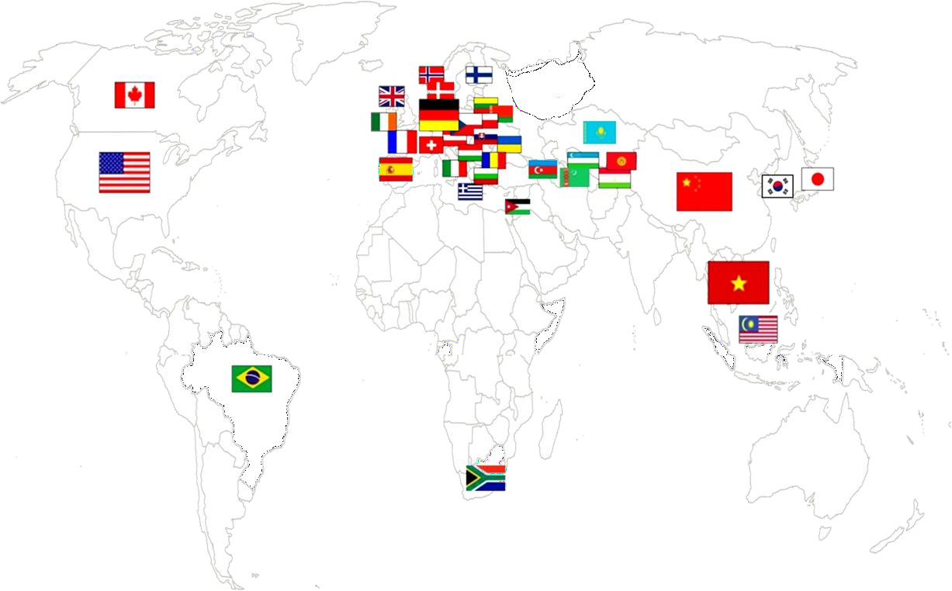
International Cooperation
122
International agreements
31
countries
worldwide

Slide 16
Export of Educational services
Percent share of foreign students
15.7 %
12.1%
10.8%
2372
10.1%
1880
1980
1742
2016
2017
2018 2019
Foreign students at KNRTU

Slide 17
Trends in the Number of International Students from Far- Abroad Countries
3%
2,4%
8.6%
8%
2%
9.3 %
2017
2018
2019
30%
58%
28%
60.8% 30%
60%
Africa
Asia
Europe
South America
North America

Slide 18
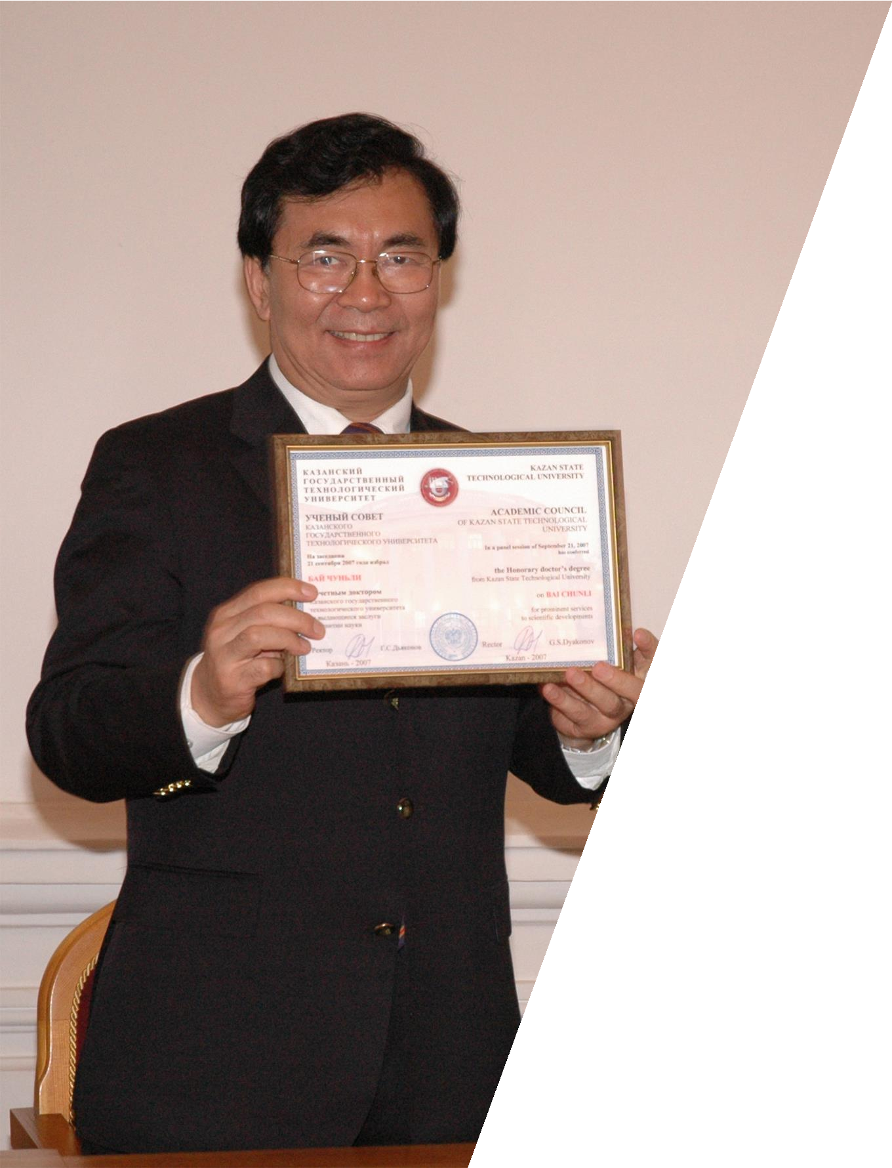
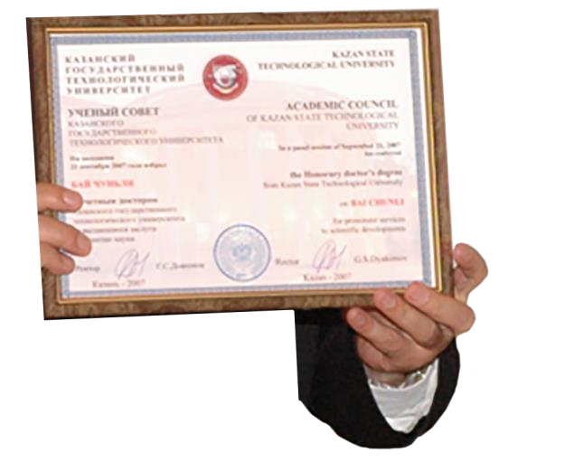
KNRTU Partners in Asia
KNRTU is one of the first Russian universities to have signed an agreement with Chinese Academy of Sciences
Bai Chunli
Honorary President of the 8th Presidium of the Chinese Academy of Sciences Honorary Doctor of KNRTU since 2007

Slide 19
KNRTU Partners in Europe
Peter William Atkins Oxford University
Honorary Doctor of KNRTU since 2009

Slide 20
KNRTU Partners in the USA and Canada
Phillip Sanger
Professor of Purdue University (USA) Honorary Doctor of KNRTU since 2020

Slide 21
Continuing professional education at KNRTU
2475
9726
FSOE Gazprom students taking CPU courses
517
271
186
5037
3407
3277
CPU graduates
2016
2017
2018
₄₄ distance-learning
programs
2019
215
CPU programs

Slide 22
Kazan National Research Technological University
INTER@KSTU.RU
+7 (843) 231-43-19
www.knitu.ru knitu_official

