Slide 1
Engaging Engineering Students in
Cultural Diversity and Unity Studies
Julia Ziyatdinova,
Elvira Valeeva,
Kazan National Research Technological University, Kazan, Russia
Olga Oleynikova,
Center for Vocational Education and Training Studies, Moscow, Russia

Slide 2
CHALLENGES FOR UNIVERSITIES
Competition in the International Market
Increase in the Number of International Students
Little Communication between the Locals and Foreigners in Engineering Programs

Slide 3
CULTURAL DIVERSITY IN UNIVERSITIES
Multicultural Environment
Students Engagement
Professors Leadership

Slide 4
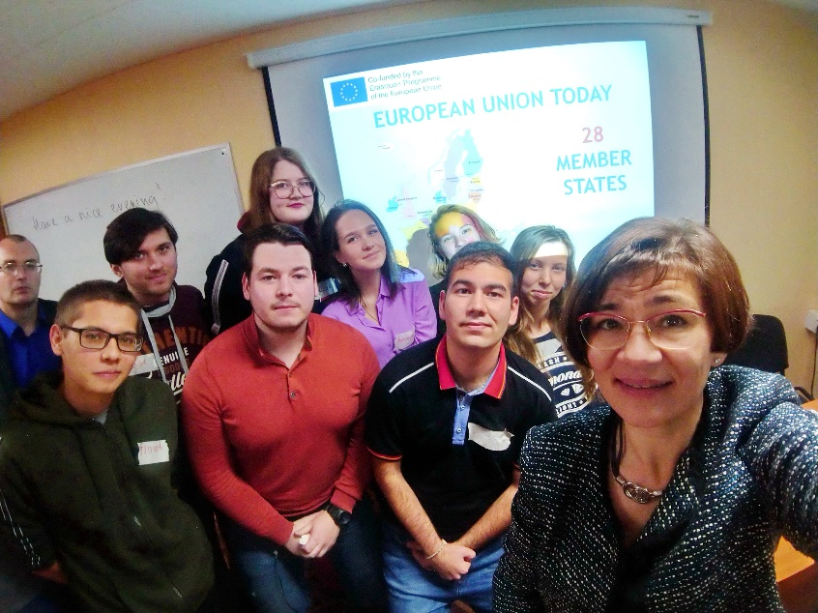
A COURSE IN CULTURAL DIVERSITY AND UNITY FOR MASTER’S STUDENTS
Under support of Erasmus+ Jean Monnet Module
“Cultural Diversity and Unity”
A group of 19 students in MEng “Innovations in Chemical Technology” (15 local, 4 foreigners)
Fall Semester 2019/2020

Slide 5
A COURSE IN CULTURAL DIVERSITY AND UNITY FOR MASTER’S STUDENTS
Approaches:
Student-centered teaching and learning
Self-directed teaching and learning through personal experience

Slide 6
A COURSE IN CULTURAL DIVERSITY AND UNITY FOR MASTER’S STUDENTS
Topics:
Europe : Cultural Identity – Cultural Diversity.
‘United in Diversity’ – cultural clusters in the EU
Culture as the element of EU external relations
EU culture in its policy on corporate social responsibility (CSR).
EU New Skills for New Jobs initiative Forecasts by CEDEFOP.
Efficiency of health saving technologies and health care systems in the EU.

Slide 7
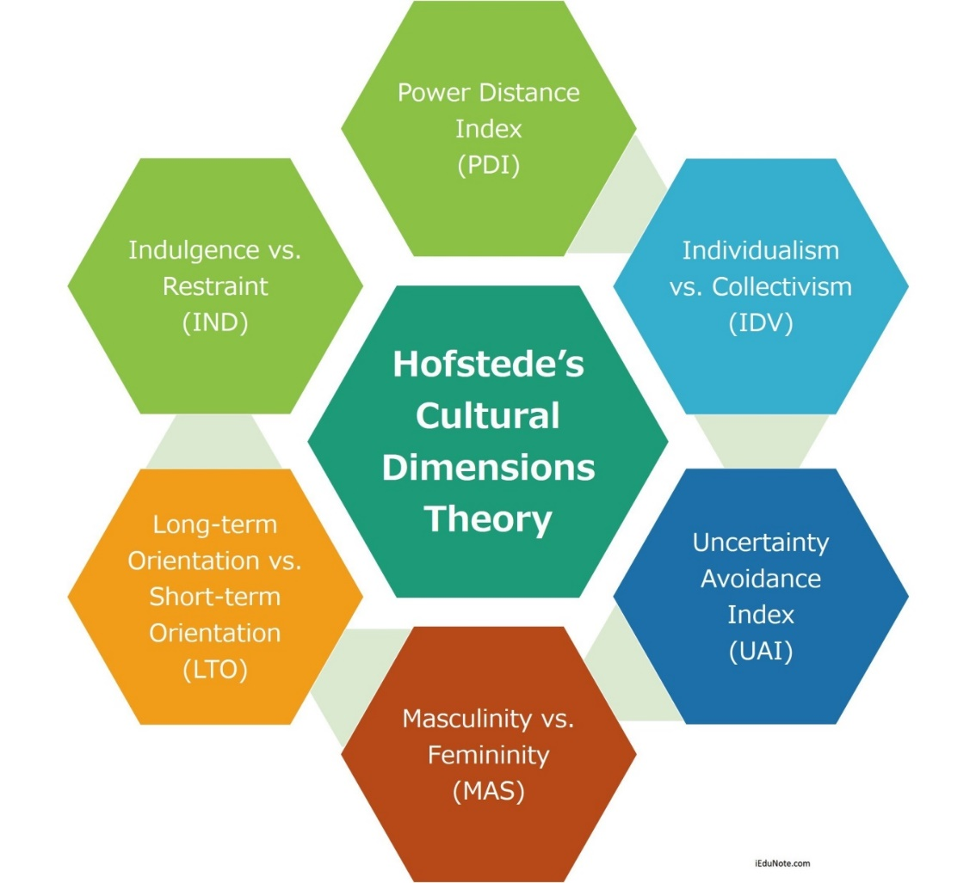
A COURSE IN CULTURAL DIVERSITY AND UNITY FOR MASTER’S STUDENTS

Slide 8
CULTURAL DIMENSIONS
https://www.hofstede-insights.com/country-comparison/portugal,russia/
Hofstede Insights – Cultural Compass

Slide 9
SURVEY ON CULTURAL DIMENSIONS FOR MASTER’S STUDENTS
Power vs. Distance
children’s opinion in the family;
believing and following the seniors;
responsibilities of employees set by the employer;
the authority of the boss at work;
changes in the political system

Slide 10
SURVEY ON CULTURAL DIMENSIONS FOR MASTER’S STUDENTS
Individualism vs. Collectivism
connections within a working team;
feeling of community;
support to each other;
promotion principles in a company;
connections between family and work.

Slide 11
SURVEY ON CULTURAL DIMENSIONS FOR MASTER’S STUDENTS
Masculinity vs. Femininity
attitudes towards the lucky and unlucky ones;
motivation in the workplace;
competition in the workplace;
male and female differences in caring attitudes;
love as intimacy and emotional support.

Slide 12
SURVEY ON CULTURAL DIMENSIONS FOR MASTER’S STUDENTS
Uncertainty Avoidance
teaching children to live under uncertainty;
respect towards general vs. specific skills;
the importance of ID documents;
demonstration of feelings in public;
rules of the society.

Slide 13
SURVEY ON CULTURAL DIMENSIONS FOR MASTER’S STUDENTS
Long-Term vs. Short –Term Orientation
the good and the evil;
balance and consistency;
why, what and how questions;
goal setting;
consistency of information.

Slide 14
CULTURAL DIMENSIONS : RESULTS
https://www.hofstede-insights.com/country-comparison/russia/
Hofstede Insights – Cultural Compass

Slide 15
CULTURAL DIVERSITY: DISCUSSION
Learning Outcomes:
better communication between local and foreign students;
better teamwork;
multicultural and friendly learning environment.

Slide 16
THANK YOU!
OBRIGADO!
Julia Ziyatdinova
uliziat@yandex.ru
+79033442406

